Slide 1
Credit Card Fraud Detection
Done by:
Bala Tej Kumar Thanneru – 00762025
Darshan Kumar Munireddy – 00760186
Lalithya Krishna Garaga - 00764409

Slide 2
Outline:
Machine Learning in Credit Card Fraud Detection.
Types of Credit Card Fraud.
Algorithms used by Machine Learning.
Approach and Analysis.
Modelling and Performance.
K Fold Cross Validation.
Important features of Random Forest.
Reference.

Slide 3
Machine Learning in Credit Card Fraud Detection:
Machine Learning is a powerful tool in credit card fraud detection. It involves training algorithms to recognize patterns and anomalies in credit card transactions.
Machine Learning algorithms can analyze vast amounts of data in real-time and identify suspicious transactions that may indicate fraud. They can also adapt to new types of fraud and improve their accuracy over time.
Financial companies and institutions use machine learning algorithm in various ways, such as anomaly detection, clustering and classification.

Slide 4
Types of credit card fraud:
There are many types of credit card fraud:
Identity theft: Involves stealing personal information to make new credit card accounts.
Account takeover: Involves taking over an existing account and using it for fraudulent activities.
Skimming: Involves stealing credit card information through devices installed on ATMs or payment terminals.
Phishing: Involves tricking people into giving away their credit card information through fake emails or websites.

Slide 5
Algorithms used by machine learning:
We are predicting credit card fraud in this project by training a data set using several machine learning techniques and comparing results of each model or algorithm.
Various machine learning algorithms are:
SVM
Logistic Regression
Naïve bayes
Random Forest

Slide 6
Approach and Analysis:
Get the data set via the API.
Exploratory data analysis.
Train the data set by using machine learning model.
Predict the model with test data
Metrics – Confusion matrix, F1 score, K Fold cross validation.
Retrieve Data
EDA
Train the Model
Predict the Model
Performance Evaluation

Slide 7
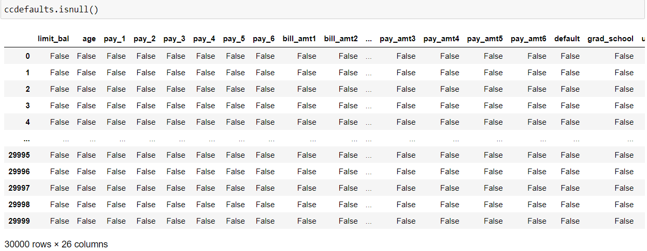
Approach and Analysis:
In this data set, we are checking for any missing values.

Slide 8
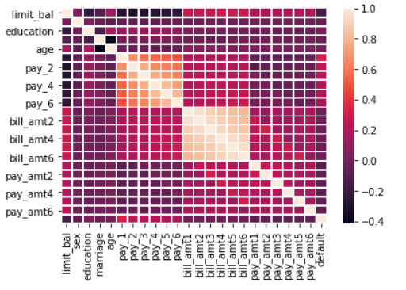
Approach and Analysis:
Correlation between features.

Slide 9
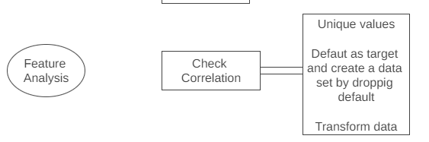
Approach and Analysis:
Find unique values in few columns.
Transform the education and martial status column values.
Set “default” as target and create a new dataset by dropping this column from original database.
Use Robust Scaler to transform the new data set from above.

Slide 10
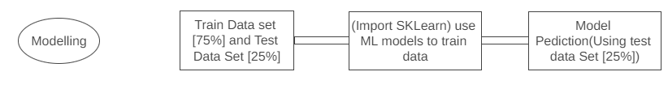
Modelling and performance:
Create the test and train data set.
From SKLearn imported the ML model.
Performed train data set on this models.
Using a test data set to predict the model.
F1 score and confusion matrix were used to evaluate the model.
K Fold Cross Validation is used to evaluate the model.
A new dataset was used to test the model.

Slide 11
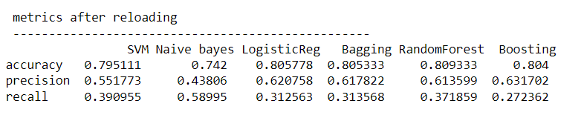
Modelling and Performance:
Performance of each models used.

Slide 12
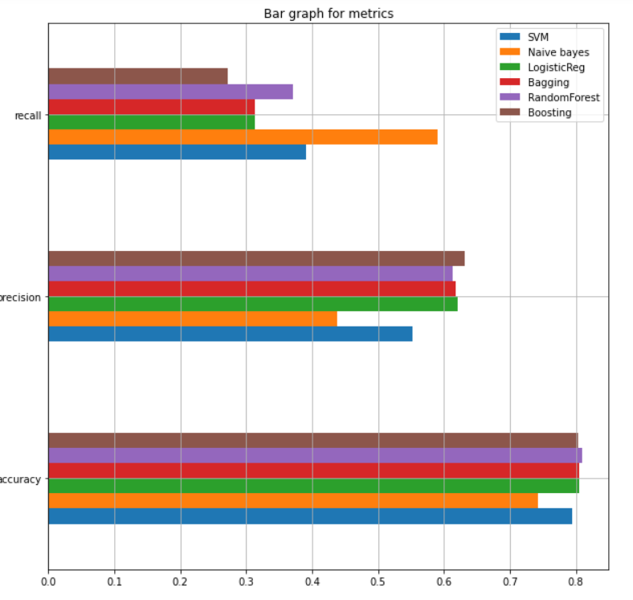
Modelling and Performance:
Representing the performance of each model visually by plotting bar graph.

Slide 13
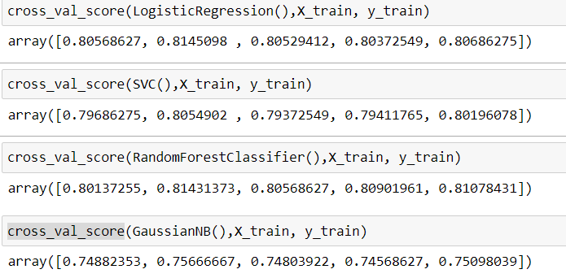
K Fold Cross Validation:
We also used K Fold Cross Validation to assess the models.

Slide 14
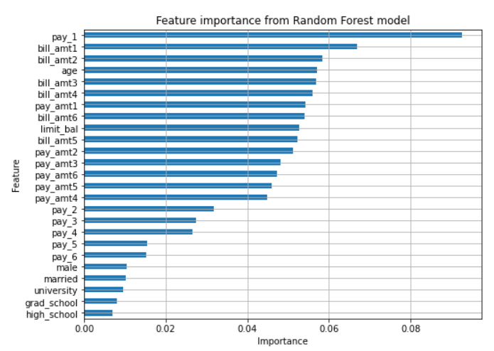
Important features for Random Forest:
We calculated important features of Random Forest model because it performed well in comparison with other models.

Slide 15
References:
https://rstudio-pubs-static.s3.amazonaws.com/281390_8a4ea1f1d23043479814ec4a38dbbfd9.html
Data retrieved from : https://archive.ics.uci.edu/ml/datasets/default+of+credit+card+clients
https://raw.githubusercontent.com/MLWave/Black-Boxxy/master/credit-card-default.csv

Slide 16
Thank You

